Slide 1
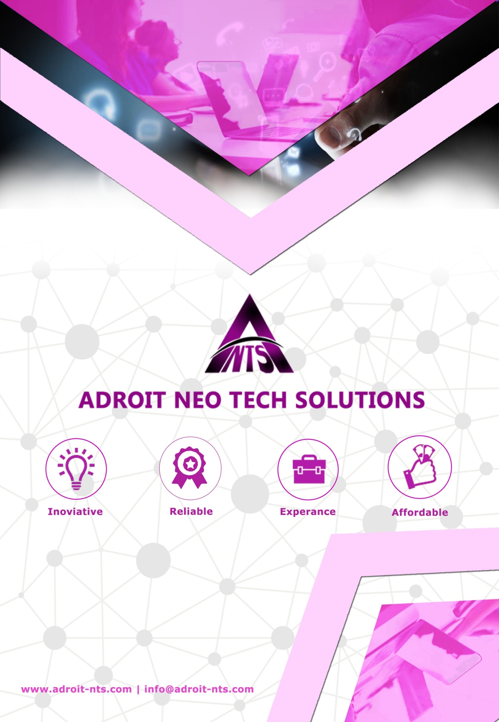

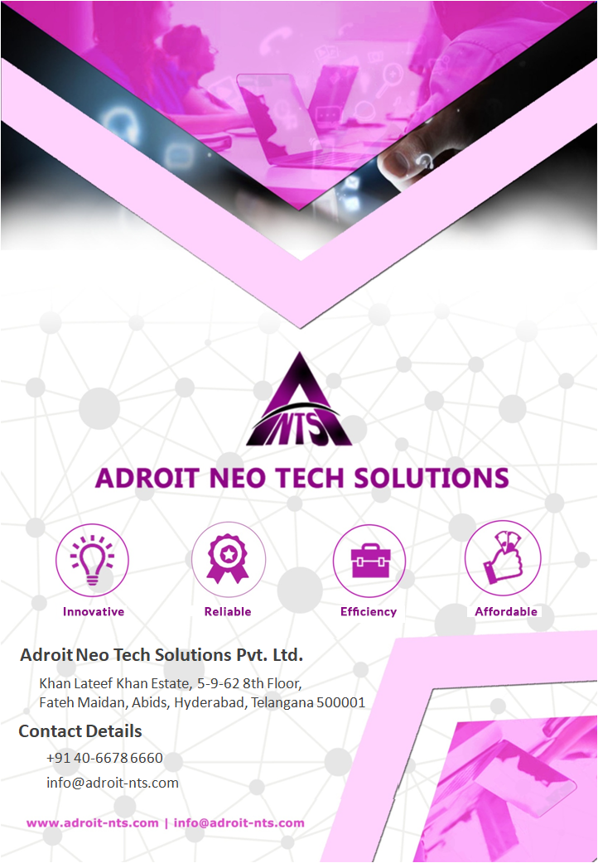



Experience
Innovative
Adroit Neo Tech Solutions Pvt. Ltd.
Adroit Neo Tech Solutions Pvt. Ltd.
Khan Lateef Khan Estate, 5-9-62 8th Floor,
Fateh Maidan, Abids, Hyderabad, Telangana 500001
Khan Lateef Khan Estate, 5-9-62, 8th Floor,
Fateh Maidan Road, Abids, Hyderabad, Telangana 500001
Contact Details
Contact Details
+91 40-6678 6660
+91 40-66616056
info@adroit-nts.com
info@adroit-nts.com

Slide 2


Content
About Us | …………………………………… | 3
Our Strength, Methodology & Assurance | …………………………………… | 4
We Work On | …………………………………… | 5
BPO and KPO Services | …………………………………… | -
Web Design and Development Services | …………………………………… | -
Digital Marketing Services | …………………………………… | -
Budget | …………………………………… | 20
Our Facility | …………………………………… | 21
Our Happy Clients | …………………………………… | 22

Slide 3

About Us
Adroit Neo Tech Solutions is an IT & ITeS company, along with Digital Media expertise established in 2010. Equipped with innumerable technologies, we have grown as a respectable independent software development company in India. We connect with customers and deliver reliable and responsive commitments in terms of time and budget.
With on-shore and off-shore delivery model approach, Adroit has developed software development process including Web Design & Development, Mobile App Development (iOS, Android), QA/Testing, Digital marketing, e-commerce, UI/UX and BPO & KPO end to end solutions.
Our web technology system offers innovative designs whereas; BPO & KPO end-to-end Solutions built mutual trust and strong relation with our customers.
Our Services
BPO / KPO end to end Solutions
Web Design & Development
Mobile App Development
Digital Marketing
UI/UX Design
E-Commerce
Vision
We aim to become the most unique IT/Software Company with innovative, time-efficient and cost-effective solutions that leads to business growth and positioning in global market in the near future.
Mission
Our mission is to enhance our client business success and build strong relation with robust solutions and latest technologies.
Quality Policy
Our dedicated team readily collaborates to maintain highest standard of quality to our product and services, to build effective improvement strategies, to enhance conversion rates and expand online exposure. We stab to deliver better value to our customers with commitment and integrity.

Slide 4

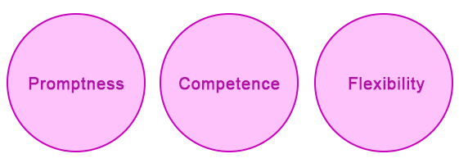
Strength
At Adroit Neo Tech Solutions, our web and mobile technologies team boast expertise and committed professional rather great teams in place to design client's needs with quality.
The principal for great achievement and success for any organization lies on team of competent professionals. We take pride due to our proficient expertise that is competent enough to address and provide quality solutions to any complex requirements of our customers.
Over the years, our strength has been lying with our team and we promote an energizing work culture by knowledge transfer and professional development over all levels.
Our group leaders just not share their field experiences but they confer best practices and industry trend patterns to their colleagues with prime thought of designing best solution to our customers.
At Adroit, we have a blend of very high and compatible developers, designers, testers, business analyst, marketing personals and project managers.
Adroit aim to become the most unique IT/Software Company with innovative, time efficient and cost-effective solutions that leads to business growth and positioning in global market in near future.
Our Methodology
Our Assurance
Business development has great importance to us, and we assure prospers by achieving, assuring and delivering our client’s contentment for the services offered.

Slide 5

We Work On
BPO and KPO Services
Introduction
ADROIT NTS BPO Services is a fast growing Business Process Outsourcing (BPO) and Call Center Services Company based in Hyderabad, India. We provide well matched, Innovative, Cost-effective and Customized BPO &Call Center solutions in India.
ADROIT NTS combines expertise, skills and technology to deliver world-class business process outsourcing. Our focus is on providing quality solutions to our clients. We are dedicated to providing superior support services including back office operations, Inbound & out-bound call centers, Human Resource services, Customer services, telemarketing, Help Desk, Technical support, Chat/Email support, Lead Generation, Data Processing, Knowledge Process outsourcing and various Web related services. We deliver value to our clients by bringing operational excellence and knowledge to their business processes.
To remain a winner amongst the competitors it’s imperative to offer best of the services and we strongly believe in that philosophy. Our approach towards offering value additions to our clients helps us to strengthen relationship and grow with them steadily. We identify opportunities, overcome obstacles and define realistic goals to achieve success.
Who We Are
Adroit Neo Tech Solutions Pvt. Ltd., specializes in providing Software Development, HR Consulting, Specialized Training for IT companies and Business Process Outsourcing services for companies worldwide.
Adroit-NTS is not just a service provider but also a committed partner who makes valuable difference to your business. With a customer-focused approach, desire to understand customer business & ability to identify the right solutions, we act as a one-stop shop for business process outsourcing from India. We promise you significant cost savings, and improve and maintain the quality of service delivery.
Our History
Adroit-NTS 9 years old BPO services are successfully providing business development, Tele marketing and recruitment process outsourcing to international clients. Fundamentally being an IT company, we exactly know how to design, use and exploit information technology capabilities to run the BPO services successfully. Our BPO wing comprises of Team Leaders, Domain Experts, BPO Executives, Technology trainers, Soft skill/Personality development trainers and accent trainers.

Slide 6
BPO and KPO Services
Our Business Vision
At Adroit-NTS, we firmly believe that our vision is the continuing driving force behind our growth. Our desire was, and still is, to build an institution that would outlast our lives, and a strong inclination towards being driven by values.
While defining our vision, we asked ourselves some fundamental questions:
  What is core to the organization?
  What is the purpose for which we exist?
  How do we envision our future?
  What goals do we set ourselves?
  What are our dreams?
The answers to these questions would give us an idea as to how we would respond to the rapidly changing environment of business. The process of answering these questions was neither quick, not painless, since we often had to come face to face with our deepest concerns. Ultimately however, we believe that we have been able to filter through the noise and settle on what truly defines Adroit-NTS as an organization.
We believe that the Internet has created a new level playing field. We seek to transform our customers by helping them use the principles of the Internet to effectively fulfill their business dreams.
We seek to transform ourselves by giving everyone in our team an environment where we can achieve our true potential.
We seek to transform our shareholders, by amply rewarding the trust that they have placed in us through their investments.
We seek to transform society by using our skills and resources to set people free from poverty, fear and whatever may hold them back from being everything that they ought to become
Our Values
Even while we embark on the roadmap that we have set ourselves, we seek to uphold the values that define the nature of our relationships with each other and with our stakeholders. Simply put, they are:

Slide 7

Integrity: Our desire to stick to our commitments whatever the cost.
Excellence: Our continuing drive to be the very best that we can be.
People: Pools of talent that is looking for
Opportunities: We will provide an environment of Leadership and transparency.
Customer: Exceeding expectations through win - win solutions.
Learning: Constant change is a reality. Our plan is to thrive on it.
Community: Our responsibility to build and enrich the community in which we operate.
Customer
Excellence
People
Our Values
Learning
Community
Integrity

Slide 8
Our Mission
At Adroit-NTS, our prime mission is to provide a seamless extension of our client’s customer relationship management process by being a premier provider of customer acquisition, customer care and retention services. To build strong client relationships and strategic partnerships through QUALITY PEOPLE, EXCELLENT SERVICE and SUPERIOR TECHNOLOGY resulting in an exceptional product and outsourcing value.
Our key values
  We maintain the highest standards of integrity and honesty
  We commit our capabilities, meet every commitment and keep our clients and colleagues informed at all times
  We earn the complete trust of each other, our clients and their customers
  We show respect for individuals - both our clients and our colleagues
  We strive for continuous improvement in everything we do
  We have fun, celebrate our successes and approach all challenges in a positive and optimistic manner
Why Outsourcing
All Outsourcing activities can be classified into three types. Basic/Traditional outsourcing services, which curb direct costs, such as hardware/software maintenance and operation costs. The second type of outsourcing helps lower "indirect" costs and achieve efficiencies in areas related to business processes. This is termed Business Process Outsourcing. At the highest level, is the Business Transformation Outsourcing.
Simply put, BPO is the delegation of one or more business processes to an external provider who in turn provides services for the selected process based on certain defined and measurable performance criteria specified by your organization. This generally involves an organization's non-core processes.
BPO is growing because companies want to focus on their core businesses. Companies worldwide feel the need to shed their ancillary processes, free up internal resources to focus on their core business competencies.
BPO is a strategic management tool that can help organizations to improve process
level efficiency and effectiveness, as well as reduce costs.

Slide 9
Business Values Of Outsourcing
Economic Of Scale
Increased
Satisfaction
Risk Mitigation
Innovation
Time Differences
Benefits
Business
Values
Increased Focus
on Core Business
Low costs
Cost Advantages- BPO provides an accounting advantage - financial engineering with regard to assets, staff and infrastructure
Innovation and speed to market- Ability of the outsourcer to do things which an organization cannot do on its own or does not have the domain expertise.
Increased customer satisfaction, more efficient operations by focused effort on customer service by the outsourcer
Economy of scale - BPO provides the flexibility to respond to a rapidly changing marketplace and scale operations up or down as conditions dictate.
Business risk Mitigation by capitalizing on the outsourcer's knowledge of local laws, infrastructure, processes and expertise.
Availability to skilled personnel also increases the quality of service Outsourcing a process also means the buyer no longer has to manage the head count. Recruiting and retaining talent in a tight market is difficult. The level of difficulty increases with the specialized knowledge required. The outsourcer, on the other hand, is adept at attracting the best and the brightest in its field.
Shorter project delivery times due to the expertise of the outsourcer with regard to transition of business processes to the offshore site.
Using the time difference to your favor, especially where the offshore company provides support or maintenance

Slide 10
Our Services
Adroit-NTS is fast growing provider of high quality customer contact center services. We operate a customer contact centers with around 50 web-enabled workstations located at Hyderabad in India. At Adroit-NTS we realize that at the center of every business is the customer. A true India based outsourcing company; we firmly believe that service delivery is more critical than customer acquisition. We are capable and our technology is par excellence.
Our key differentiators are our teams of professionals, a proven process transitioning methodology and facilities that beat world standards. We complement our strong global orientation with a thorough understanding of the Indian operating environment. We have the people who treat your customers the old-fashioned way... With courtesy, friendliness and intelligence.
We allow your customers, to contact us in any manner and at any time that they choose. With, Adroit-NTS your customers have unlimited access to your products or services.
Services offered By Adroit-NTS
Back Office Services
24/7 Customer believes in a holistic approach towards customer experience management. Go4Callcenter transcend the transaction-based approach to proactively carry out back office operations. This enables your organization to seamlessly deliver services to your customers. Under this ambit, our services cover credit card verifications, processing of transactions, accounts receivables, alerts for direct mail campaigns etc.
Our Key Purpose
  Providing customers with a dependable method of contact, through the channel of their choice, and a boulevard to have their questions answered in a professional manner.
  Improving brand image by providing service professionals who have access to accurate, up-to-date information and can assist customers with timely issue resolution.
  Capturing customer service information regarding areas of service issues and customer needs to be analyzed for adaptation into market opportunities.
  Integrating operations platforms, with the ability for work inter-flow between outsourced customer contact centers, other third party vendors and internal centers as necessary.

Slide 11
Inbound Call Center Services
We use and deploy the most refined call processing and telecom. Our call routing feature allows the system to instantly scrutinize available agents and route calls to the most suitably skilled agents. Our operating centers receive customer calls over dedicated international private leased circuits. We can handle calls relating to various products or processes across industries.
Outbound Call Center Services
We have got a robust infrastructure to manage campaigns for our clients. We can manage a broad range of outbound services for clients across various industry segments. We have the expertise to set up and manage large outbound call center operations. Our agents are proficient in handling the entire gamut of calls, from simple welcome calls to calls pertaining to surveys, verifications, lead generation, collections, etc.
Our Process
We are a process centric organization, constantly striving to set new benchmarks in customer satisfaction and operational excellence.
We at Adroit-NTS follow a robustly defined operational procedure to ensure process integrity and minimize inherent outsourcing risks. We help clients establish the right outsourcing strategy, and help them in devising a plan to implement the strategy and de-risking the plan to ensure success.
  Pre Analysis: At this stage, we try and understand clients' business, identify outsource opportunities, assess requirements, review environment and confirm validity.
  Analysis: For analyzing, we gather documentation, identify solution and costing, confirm and validate with client and prepare the process implementation plan.
  Transition Management: At this juncture, we adapt process plan, emulate client process, document operating plan, and confirm performance requirements.

Slide 12




How are we unique?
The biggest challenge that the BPO industry in India faces in India is the high attrition rate. Qualified people are selected, trained, inducted and they leave after short span of time. Adroit-NTS follows multiple strategies in order to tackle this problem.
Attrition Issues
Continuous
creation of
backup
resources
Higher
rewards for
key
resources
Wide
Career Path
Industry
Standard
Training
The first strategy is that through our HR consulting wing, we constantly keep interviewing and recruiting people as backup resources. An employee, when he puts down his papers, within no time, the backup resource is placed along with that employee, in his notice period. The employee trains the backup resource and gets it up to speed and the moment the employee leaves, the backup resource is deployed in place. This strategy has successfully worked for us and has caused zero impact to our client’s business.
2. The second strategy is to identify key people and reward them with higher compensation and incentives in such a way that they always feel satisfied and delighted to be in Adroit-NTS.
3. The third one is that, because of Adroit-NTS’s multiple business areas, an employee has a wide career path to choose within the organization itself. For example, after being a tele-marketer or a BPO executive, he could go on to become a team leader or a trainer or move in to our domestic consulting or get placed in to the software development division. This makes an employee stay longer and within the same organization, thus benefiting our clients over all.
We also have constant employee motivation programs and other industry standard training programs.

Slide 13
Infrastructure
Adroit-NTS provides its customers a 24 x 7 help desk support with effective delivery of services. The infrastructure backbone is built on high-speed, redundant, reliable voice and data networks that ride on best-in-class technologies. 24/7's highly skilled technology support teams ensure that the infrastructure is available round the clock. Adroit-NTS can support diverse operations and can be scaled up quickly to meet customer's increasing business needs. 24/7 leverages strong relationships with leading technology vendors to access and acquire the latest technologies.
Our Infrastructure includes:
  State-of-the-art computerization with fully automated call desks
  Uninterrupted and back up power supply
  Fully redundant voice and data communications with security
  Dedicated high speed internet connectivity
  Scalable capacity
  Manned and logical data security at entrances
  Layered access to physical locations and data
  Commercial grade firewall
  Network intruder detection system for extra data security
  Layer 4 switching with advanced router module for intelligent data routing, monitoring and security
Voice Infrastructure
Flexibility: It can analyze the performance of a single agent, or thousands of agents, splits or agent/skill pairs.
Reports Management: Provides over 100 real-time and historical management reports to help you achieve critical sales and customer service objectives.
Strong Administrative Interface: Provides an administrative interface to the ACD feature of the DEFINITY ECS—allowing administrators to access the database, generate reports, administer ACD parameters and monitor call activities to determine the most efficient service possible for our customers.
Call Recorder from Adroit-NTS
  Full Time Recording
  Screen Capture
  Event based Recording
  Rule Based Recording
  Recording On Demand
  Quality Monitoring

Slide 14
Digital Phones and Headsets for CSR
  6408D for CSR
  Call Master V for supervisors
  Plantronics noise canceling headsets
System Security
(Antivirus Protection)
  Installation of antivirus software for each virus entry point on the network such as Internet gateway, mail servers, LAN servers, desktop on LAN, laptops and standalone PCs.
  Updating program components and virus pattern files to stop the latest viruses.
  Disable floppy drive access on all workstations.
  Check and clean all floppies and CD media before using.
  Perform a Virus Cleaning exercise once in three months.
  Daily Backup and offsite storage of month end backup tapes.
User Data Security
Dedicated folders on file server. The access to these folders is dependent on the access privileges given to each individual user. All system files/directories are write protected from users.
Backup for this server taken on a daily basis.
The floppy drives at each of the user is disabled.
As we are using Windows 2000 as an operating system, we have disabled the control panel access and command prompt access for all the CSEs.
No default administration access is allowed to CSEs and no access provided to users for modifying BIOS.
CSR are given the access to the Internet as per the process requirement and all other access is denied.
All the attachments in the mail going outside are restricted and are regularly screened by email content manager of Trend Micro and in turn monitored by system and administration department.
Incoming *.exe, *.eml etc attachments are not allowed and this list gets updated on ant virus software (Trend Micro) updates. This is done to prevent the flow of disastrous viruses.
No media is allowed inside the process floor.
No user is allowed to carry the bags and any food item/beverages on the working floor.

Slide 15
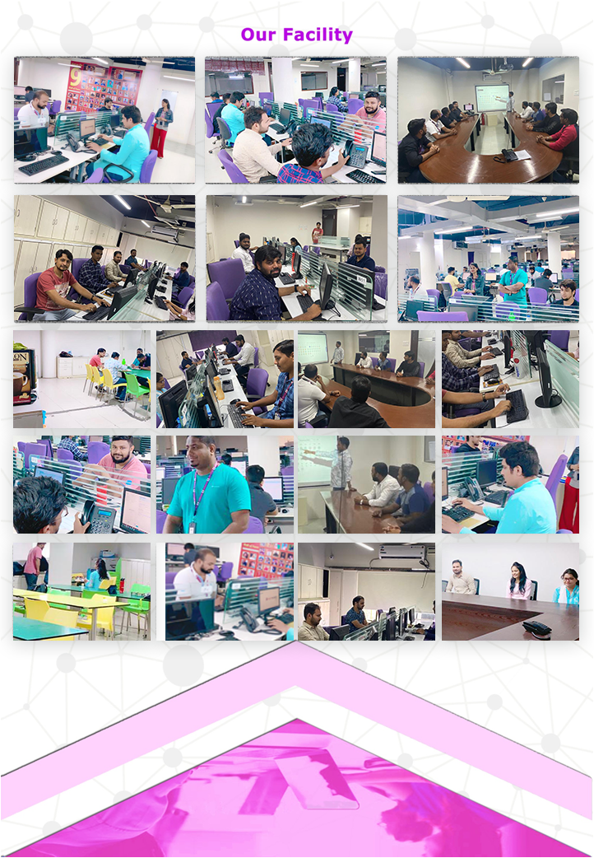

Slide 16
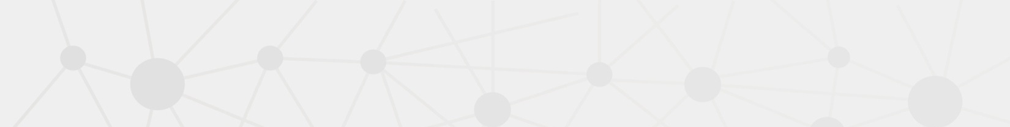





Few Of Our Clients
Super Escapes Travel is an ‘All-Travel’ shop catering to all your travel needs. From Flight seats to Airport transfers, Airport Parking, Hotel/Resort Accommodations from over
Data Direct is among the top lead generation company in Dubai offers reliable lead generation service helps b2b business attain their revenue goals.
Discover the Edenred Group, a leading services and payments platform and everyday companion for people at work in 46 countries.
Search A Holiday (Trading Name of Holidays Away Limited – Company Registered Number: 10701623) is a holiday comparison website, enabling you to search and compare
WOWCHER, a "deal a day" site that uses the power of group buying or bulk buying to get unbeatable deals on the best stuff to do, see, visit, eat and buy in a variety of cities in the UK.

Slide 17



Few Of Our Clients
LivingSocial is a leading website offering daily deals to buy and share the best things to do in your city - or wherever you may be. LivingSocial provide a trusted,
convenient source for finding value on everyday items and activities and identifying novel
Book It Now is a Tour and Travels Company that provides a variety of ABTA & ATOL Protected packages for all your travel needs. The packages include Summer Vacation Package Deals,
Holidays to compare Travel is an ‘All-Travel’ shop catering to all your travel needs. From Flight seats to Airport transfers, Airport Parking, Hotel/Resort Accommodations from over 200 hundred

Slide 18
